Slide 1
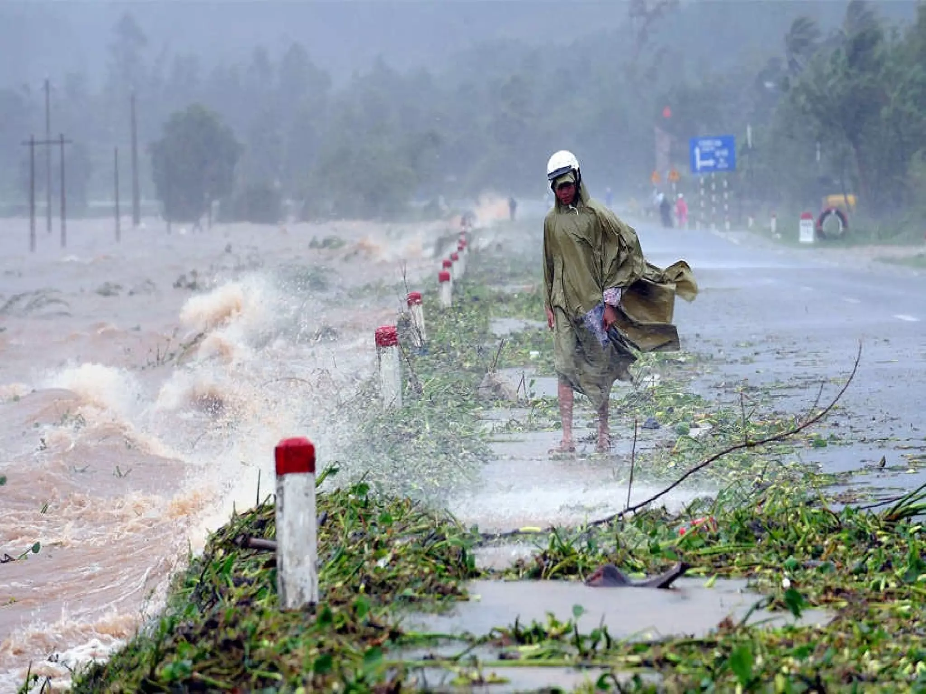
STORMS OF LIFE
Philippians 4:7
Ptr. Rod Lago

Slide 2
Philippians 4:7 NIV
And the peace
of God,
which transcends all understanding,
will guard your hearts and your minds in
Christ Jesus.

Slide 3
I.
THE REALITY OF STORMS
* Acknowledge that life is not always easy. Storms are inevitable.

Slide 4
I.
THE REALITY OF STORMS
James 1:2-3 "Consider it pure joy, my brothers and sisters, whenever you face trials of many kinds, because you know that the testing of your faith produces perseverance."
* Acknowledge that life is not always easy. Storms are inevitable.

Slide 5
II.
GOD'S PRESENCE IN THE STORM
* God is not absent during our storms;
He is with us.

Slide 6
II.
GOD'S PRESENCE IN THE STORM
Isaiah 41:10, "Fear not, for I am with you; be not dismayed, for I am your God; I will strengthen you, I will help you, I will uphold you with my righteous right hand."
* God is not absent during our storms;
He is with us.

Slide 7
III.
NAVIGATING
THE STORM
* There are practical steps to take during challenging times:

Slide 8
III.
NAVIGATING
THE STORM
*prayer,
seeking support from others, relying on God's promises, maintaining faith.

Slide 9
III.
NAVIGATING
THE STORM
Psalm 23:1 "The Lord is my shepherd,
I lack nothing."

Slide 10
IV.
THE CALM AFTER THE STORM
Romans 8:28 "All things work together for good, to those who loved God and called according to His purpose.

Slide 11
Conclusion :
Let us continue to trust in God's unwavering power, love and strength during our storms of life.

